Slide 1
DESIGN OF DDB
PRESENTED BY :
Bijali Jayalakshmi Jayan
S2 MSC COMPUTER SCIENCE

Slide 2
CONTENTS
INTRODUCTION- DEFINITION
DISTRIBUTED DATA STORAGE
DATA TRANSPARENCY
DISTRIBUTED TRANSACTION PROCESSING
COMMIT PROTOCOLS
CONCLUSIONS

Slide 3
DDB INTRODUCTION
A DDB is an Integrated collection of databases that is physically distributed across sites in a computer network.
To form a ddbs , the file must be structured ,logically ,interrelated & physically distributed across multiple sites.
A ddb is a collection of multiple logically related db distributed over a computer n/w and a ddbms as a s/w s/m that manages a ddb while making the distribution transparent to the user

Slide 4
Site 3
Site 2
Site 1
Communicatn n/w
Site 4
Site 5

Slide 5
Ddb enviroments
homogeneous
heterogeneous
autonomous
Non autonomous
federated
Multi db

Slide 6
STORING DATA IN DDBMS
In DDBMS, relation are stored across several sites.
Accessing a relation stored at a remote site incurs message passing cost and to reduce this overhead, a single relation may be partitioned or fragmented across several sites.
Data fragmentation
Data replication

Slide 7
fragmentation
Fragmentation consists of breaking a relation into smaller relations or fragments and storing possibly at different sites.
Fragmentation can 3 types:
Horizontal Fragmentation
Vertical Fragmentation
Mixed Fragmentation

Slide 8
Horizontal fragmentation
In horizontal fragmentation, each fragment consist of a subset of rows of original relation.
Is a horizontal subset of a relation which contain those of tuples which satisfies selection condition.
E.g.:) employee relation with selection condition. (branch like Mumbai)
All tuples satisfy this condition will create a subset which will be a horizontal fragment of employee relation.
A selection condition may be composed of several condition connected by AND or OR.

Slide 9
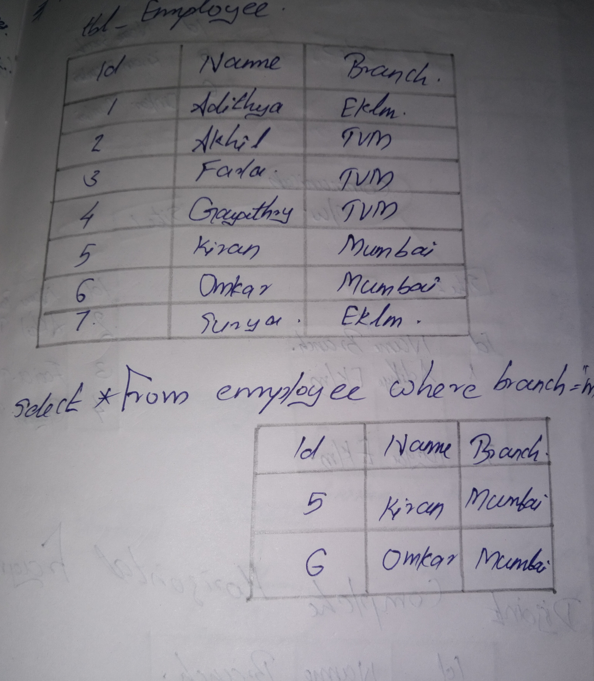

Slide 10
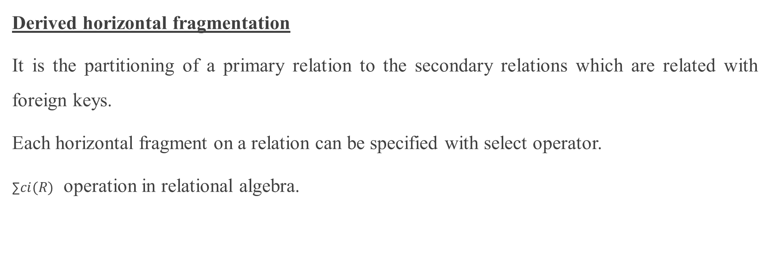
Derived horizontal fragmentation
It is the partitioning of a primary relation to the secondary relations which are related with foreign keys.
Each horizontal fragment on a relation can be specified with select operator.
∑$ci(R)$ operation in relational algebra.

Slide 11
Complete horizontal fragmentation
a set of horizontal fragments whose conditions C1, C2,….., Cn include all the tuples in R, every tuple in R satisfies [C1 or C2 or….. Or Cn]

Slide 12
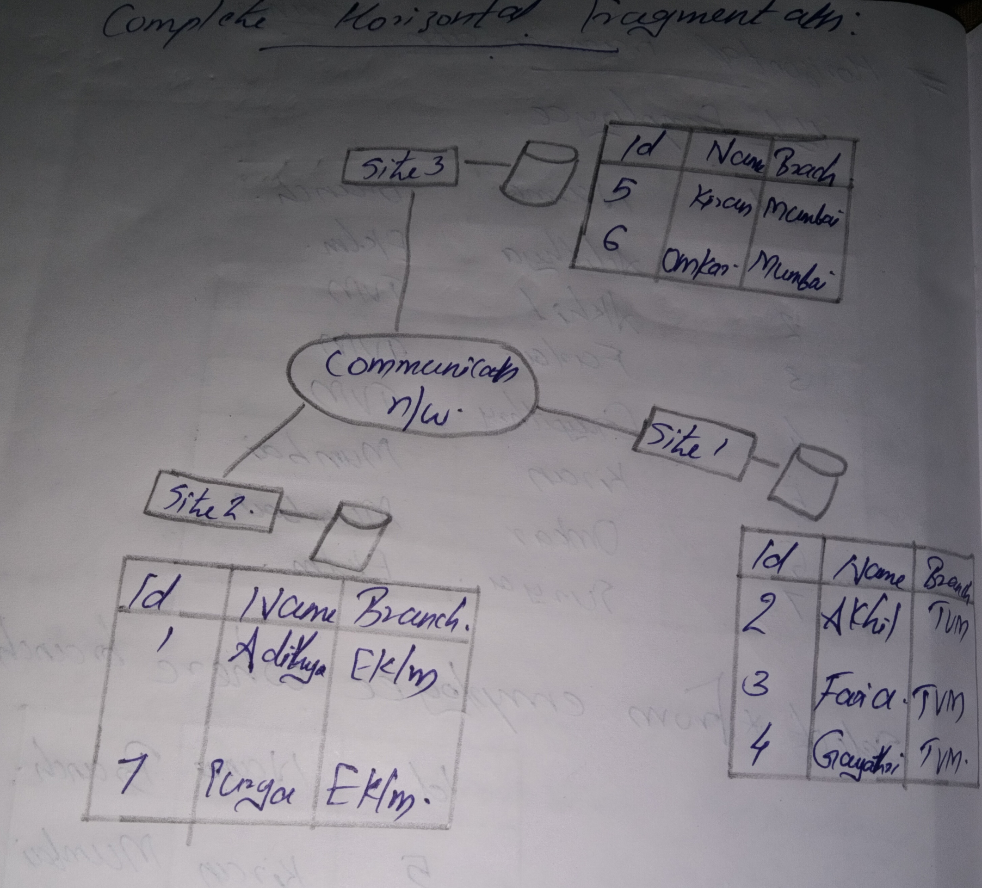

Slide 13
Disjoint complete horizontal fragmentation
No tuple in R satisfies:
(Ci AND Cj) where i≠j
To reconstruct R from horizontal fragments a UNION is applied

Slide 14
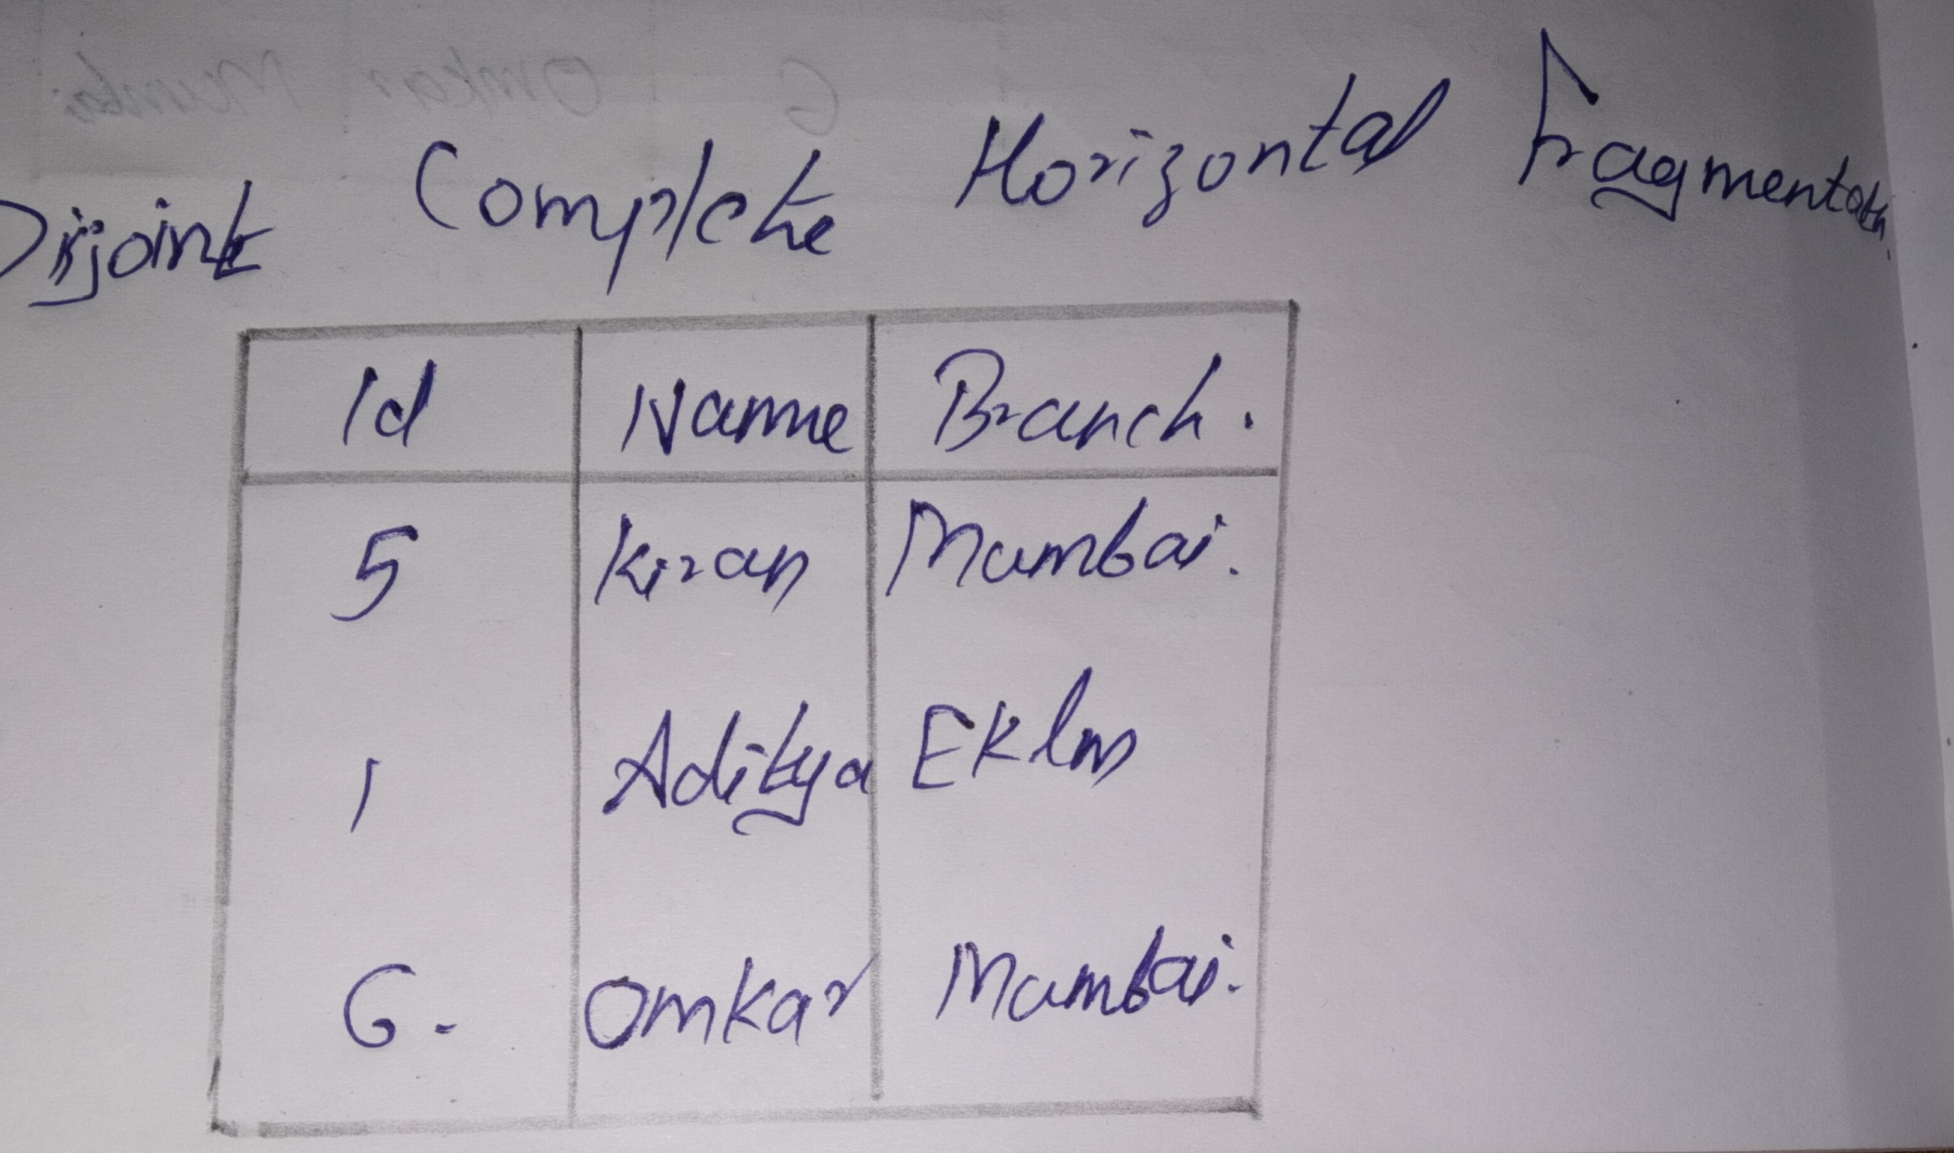

Slide 15
Vertical fragmentation
In vertical fragmentation, each fragments consist of subset of columns of original relation.
Project operation
Li – attributes

Slide 16
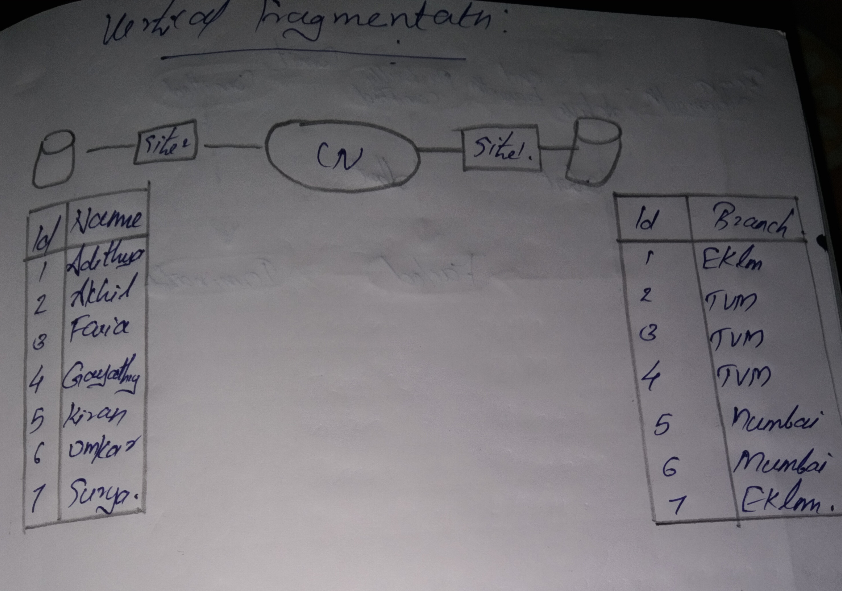

Slide 17
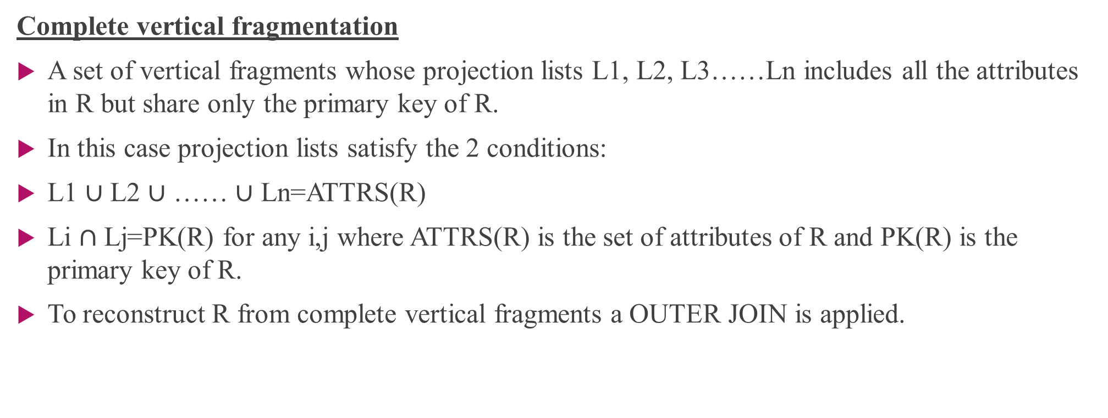
Complete vertical fragmentation
A set of vertical fragments whose projection lists L1, L2, L3……Ln includes all the attributes in R but share only the primary key of R.
In this case projection lists satisfy the 2 conditions:
L1 $∪$ L2 $∪$ …… $∪$ Ln=ATTRS(R)
Li $∩$ Lj=PK(R) for any i,j where ATTRS(R) is the set of attributes of R and PK(R) is the primary key of R.
To reconstruct R from complete vertical fragments a OUTER JOIN is applied.

Slide 18
Data replication
In no replication, the database is not replicated.
In full replication, the entire database is replicated.
In partial replication, some selected part is replicated to some of the sites.
Data replication is achieved through a replication schema.
Replication means that we store several copies of a relation or relation fragments.
An entire relation can be replicated at one or more sites.

Slide 19
One or more fragments can be replicated at other sites.
The motivation of replication is two fold:-
Increased availability of data :- If a site that contains a replication goes down, we can find the same data at other sites.
Faster query evaluation:- queries can execute faster by using a local copy of a relation instead of going to remote site

Slide 20
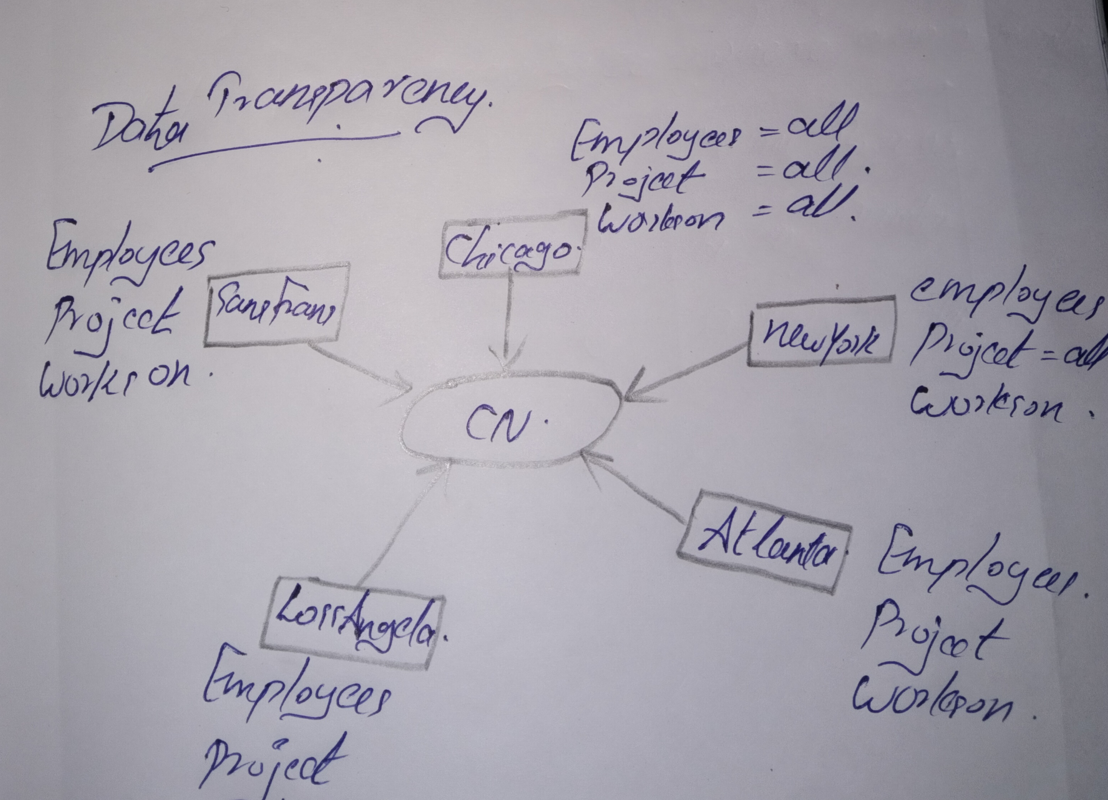
Data Transparency
Management of distributed data with different levels of transparency.

Slide 21
Distribution Transparency
This refers to the physical placement of data (files, relation, etc) which is not known to the user
Network transparency
Users do not have to worry about operational details of the network
Network transparency are 2 types:
Location transparency
Naming transparency

Slide 22
There is a location transparency, which refers to freedom command from any location without affecting its working
Then there is naming transparency, which allows access to any names object (files, relation, etc) from any location
Replication Transparency
It allows to stores copies of data at multiple sites.
This is done to minimize access time to the required data.
Fragmentation Transparency
Allows a fragment a relation horizontally or vertically.

Slide 23
DISTRIBUTED TRANSACTION PROCESSING
TRANSACTION MANAGERS
It is components.
Implemented using 2 phase commit (2pc) or 3 phase commit (3pc)
TRANSACTION TYPES
Local Application := Application which do not require data from other sites.
Global Application :=Application which do require data from other sites.

Slide 24
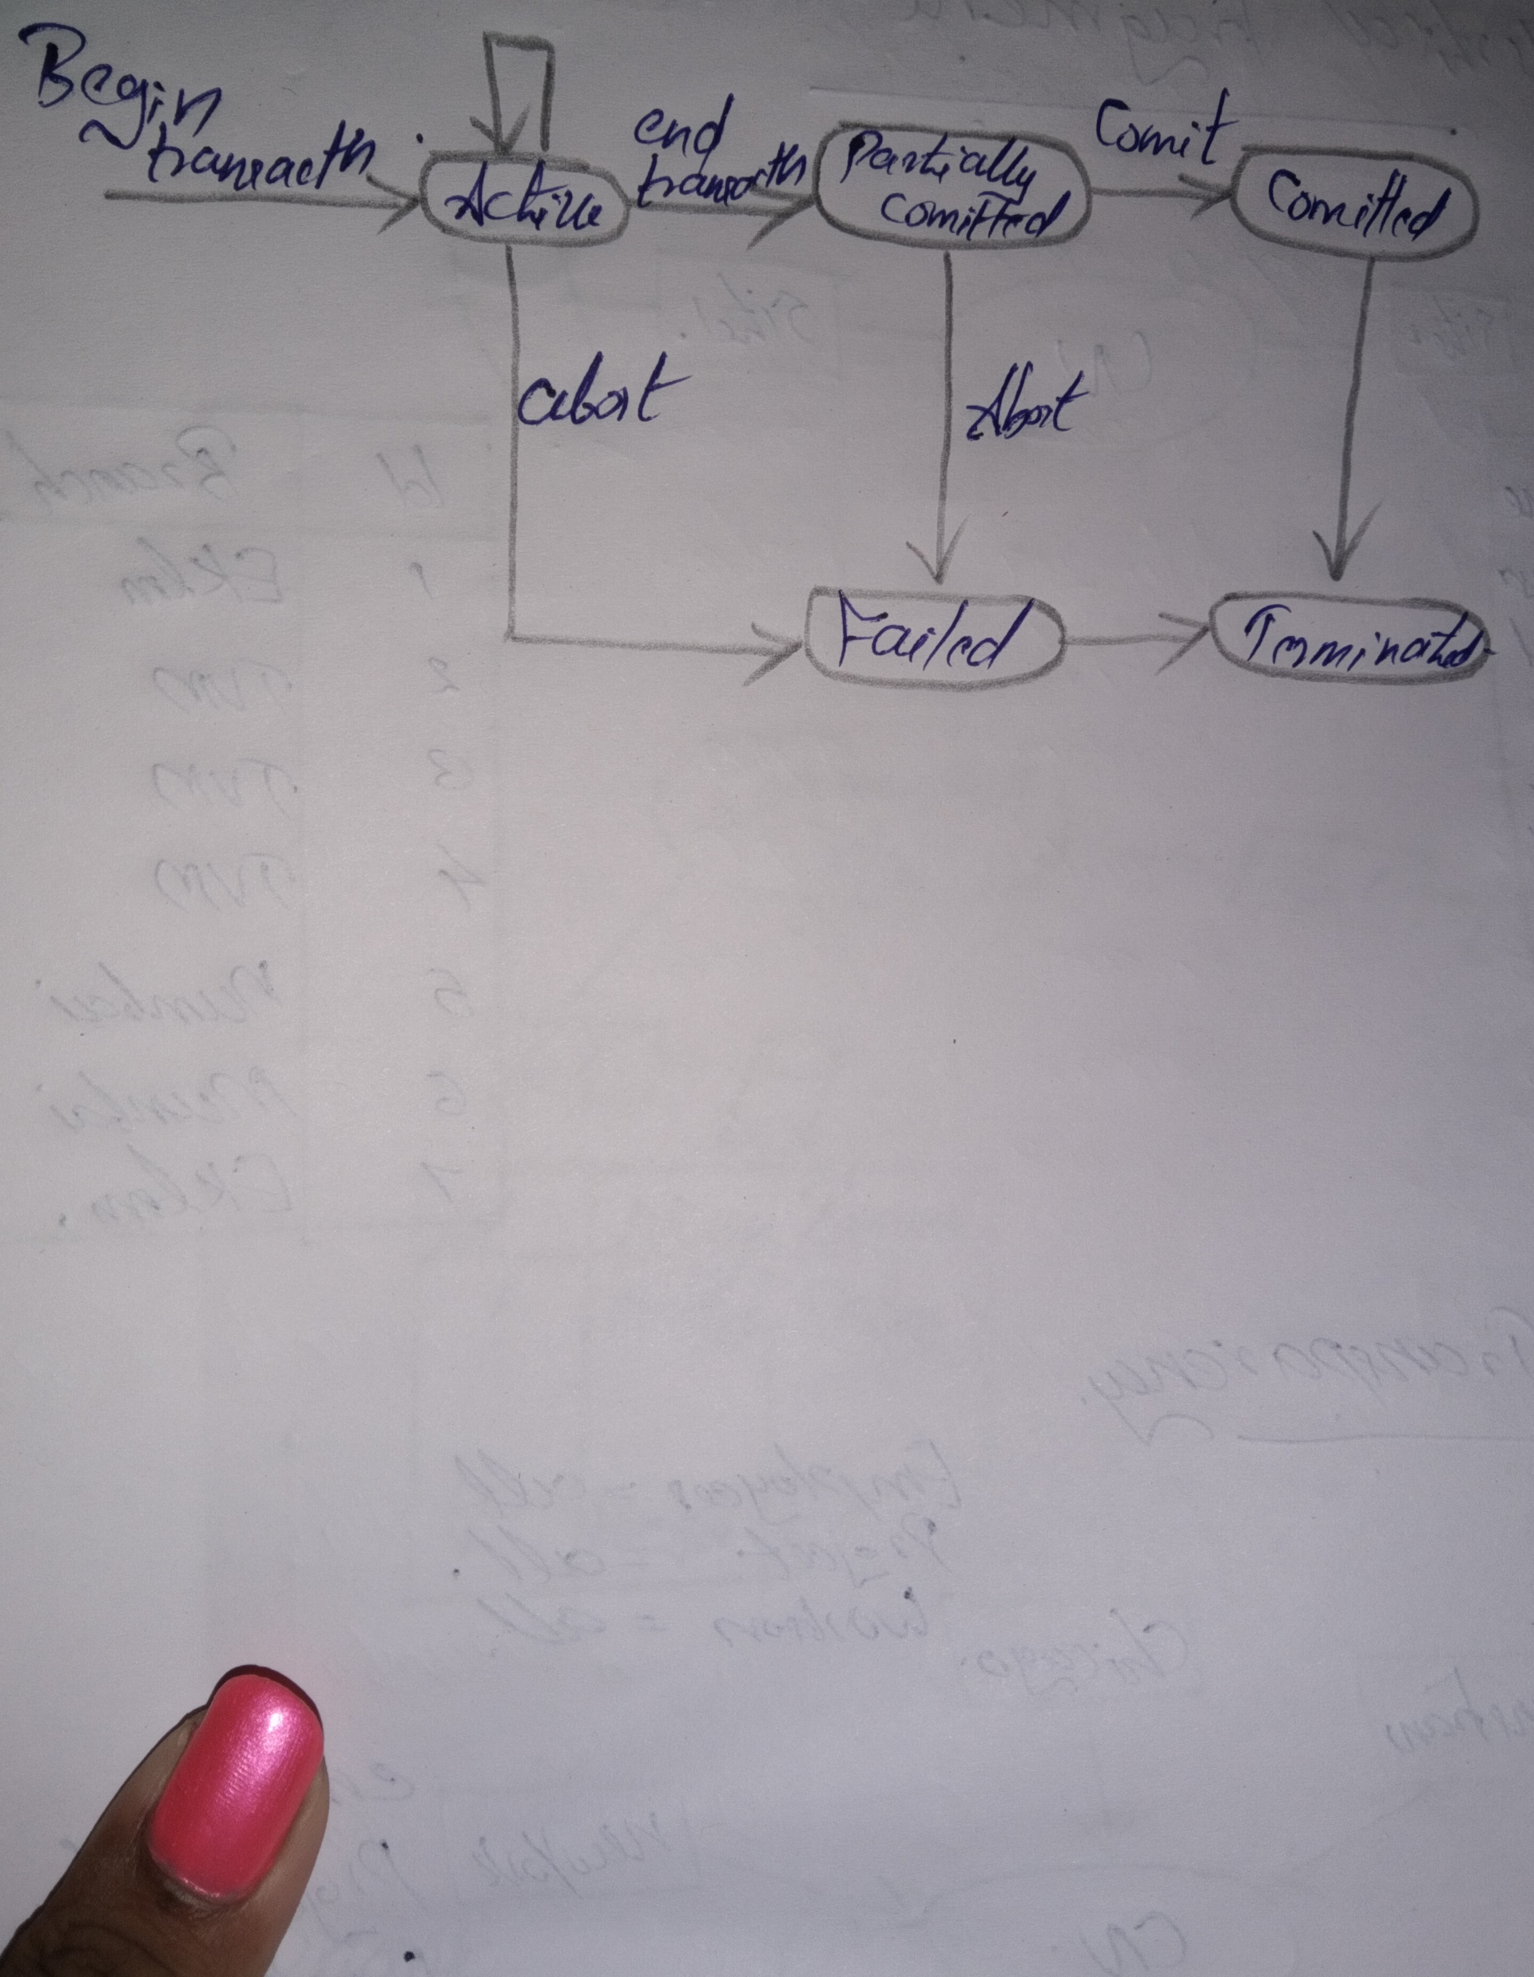

Slide 25
COMMIT PROTOCOLS
2PC is commonly used.
3PC is complicated and expensive. But avoid local problem in 2PC
Commit protocols are used to ensure atomicity across sites
A transaction which executes at multiple sites must either be committed at all sites, or aborted at all the sites.
Not acceptable to have a transaction committed at one site and aborted and another.

Slide 26
2 PHASE COMMIT PROTOCOL [2PC]
Assumes fail stop model := failed sites simply stop working, and do not cause any other harm, such as sending incorrect messages to other sites.
Execution of the protocol is initiated by the coordinator after the last step for the transaction has been reached.
The protocol involves all the local sites at which the transaction executed.
Let T be the transaction initiated at site Si and let the transaction coordinator at Si be Ci.

Slide 27
Phase 1: obtaining a decision
Coordinator asks all participants to prepare to commit transaction Ti.
Ci adds the records <prepare T> to the log and forces log to stable storage.
Sends prepare T message to all sites at which T executed.
Upon receiving message, transaction manager at site determines if it can commit the transaction.
If not, add a record < no T> to the log and send abort T message to Ci.
If transaction can be committed, then:
Add the record <ready T> to the log.
Force all records for T to stable storage.
Send ready T message to Ci.

Slide 28
Phase 2: recording the decision
T can be committed of Ci received a ready T message from all the participating site . Otherwise T must be aborted.
Coordinator adds a decision records, <commit T> or <abort T> to the log and forces record onto stable storage .
Once the record stable storage it is irrevocable.
Coordinator sends a message to each participant informing it of the decision.
Participants take appropriate action locally.

Slide 29
Handling of failures (2PC)
SITE FAILURE
When site Si recovers, it examines its log to determine the fate of transaction active at the time of the failure.
Log contains <commit T> record: site executes redo(T).
Log contain <abort T> record: site executes undo(T).
Log contains <ready T> record: site must consult Ci to determine the fate of T.
If T committed, redo(T)
If T aborted, undo(T)

Slide 30
The log contains no control records concerning T replies that Sk failed before responding to the prepare T message from Ci.
Since failure of Sk precludes the sending of such a response Ci must abort T.
Sk must execute undo(T).

Slide 31
COORDINATOR FAILURE
If coordinator fails while the commit protocol for T is executing then participating sites must decide on T’s fate.
If an active site contains a <commit T> record in its log, then T must be committed.
If an active site contains an <abort T> record in its log, then T must be aborted.
If some active participating site does not contain a <ready T> record in its log, then the failed coordinator Ci cannot have decided to commit T can therefore abort T.

Slide 32
If none of the above cases holds, then all active sites must have a <ready T> record in their logs, but no additional control records . In this case active sites must wait for Ci to recover, to find decision.
BLOCKING PROBLEM
Active sites may have to wait for failed coordinator to recover

Slide 33
Recovery in ddb
Failure of sites
Failure of a communication link.
Loss of messages
Recovery can be done using 2 PC or 3PC by writing logs in stable storage of each site .

Slide 34
CONCLUSIONS
A distributed database management system governs the storage and processing of logically related data cover interconnected computer systems in which both data and processing functions are distributed among several sites .
DBMS must have at least the following functions to be classified as distributed :
Application interface to interact with end user or application programs and within the distributed databases.
Validation to analyse data requests .

Slide 35
Transformation to determine which data request components are distributed and which ones are local .
Query optimization to find the best access strategy .
Mapping to determine the data location of local and remote fragments .
I/O interface to read or write data from or to permanent local storage .
Formatting to prepare the data for presentation to the end user or an application program .

Slide 36
Security to provide data privacy at both local and remote databases .
Backup and recovery to ensure the availability and recoverability of the databases in case of failure.
DB administration for the database administrator .
Concurrency control to manage simultaneous data access and ensure data consistency across database fragments in the DBMS .
Transaction management to ensure that the data move from one consistent state to another .

Slide 37

!!!!!!!

